Slide 1
Project 2: Random Processes & Complex Systems
Elias Rilegård • 2022-11-25

Slide 2
2.1: Polymers as Random 2D Walks
Organic polymers
Approximation and simulation using mathematical random walks
What’s a random walk?
Discrete: single/unit steps
Steps in cardinal directions

Slide 3
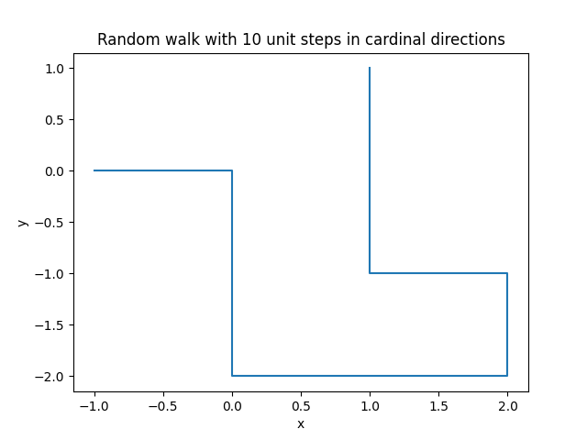
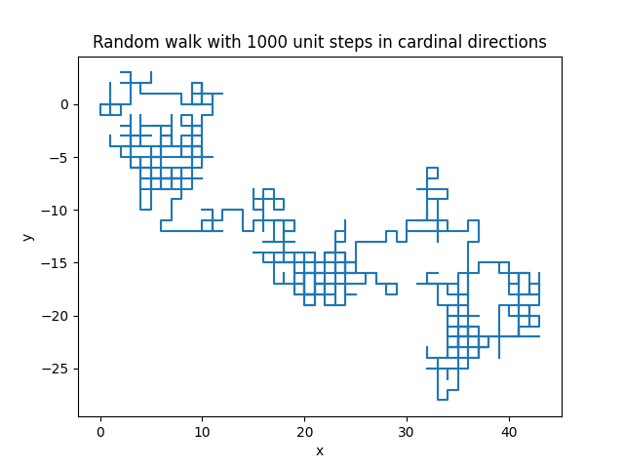
Part a)

Slide 4
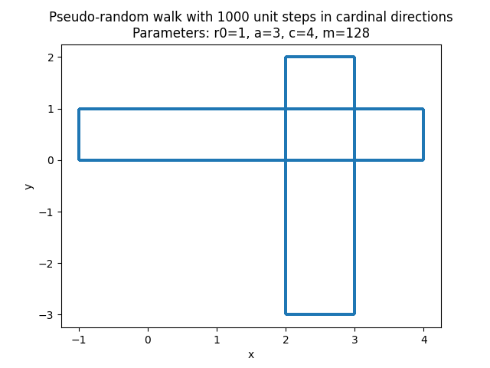
Part b)
Custom RNG
r(n) = (a * r(n-1) + c) mod m
Default:
r(0) = 1, a = 3, c = 4, m = 128

Slide 5
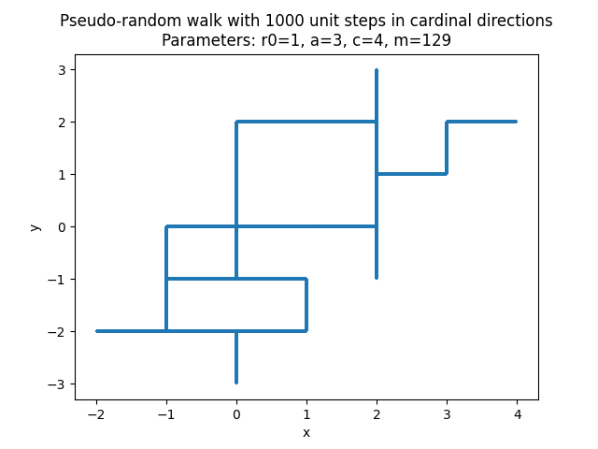
Part b)
Other parameters
m = 129 (Shown on the right)
Still highly periodic
Random parameters?

Slide 6
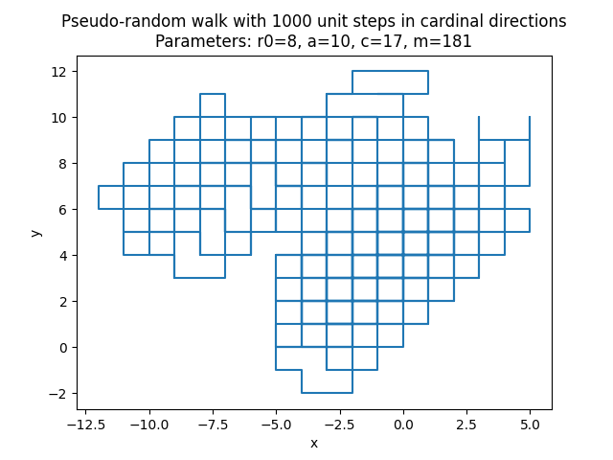
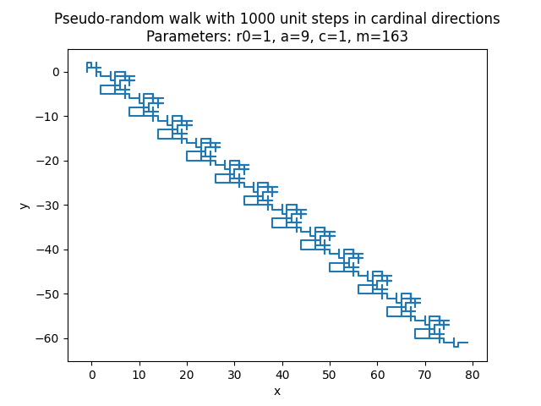
Part b)

Slide 7
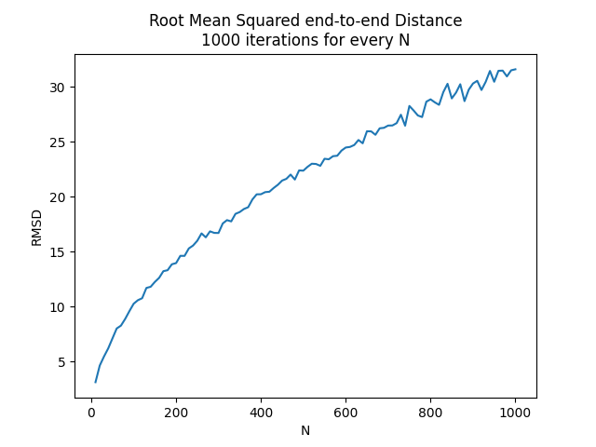
Part c)
Analysis
Root mean square end-to-end distance RMSD
Root mean square fluctuation RMSF
Standard Error Estimate SEE

Slide 8
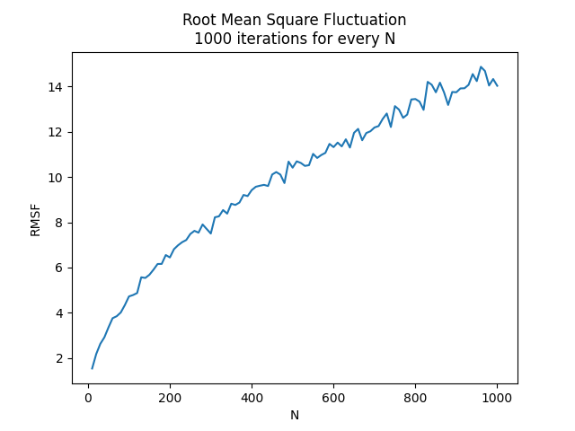
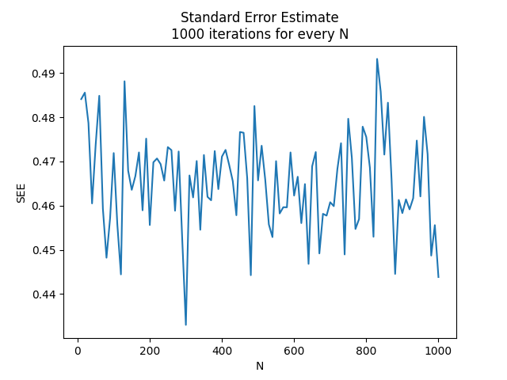
Part c)

Slide 9
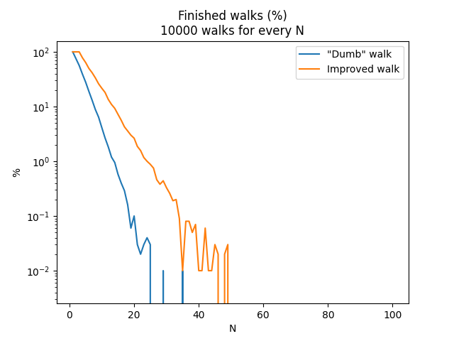
Part d)
Self avoiding walk
Real polymers cannot self intersect: Self avoiding walk
Discard walk if it self intersects
Improvement: allow only left, right, and straight ahead
N = 35 reasonable limit

Slide 10
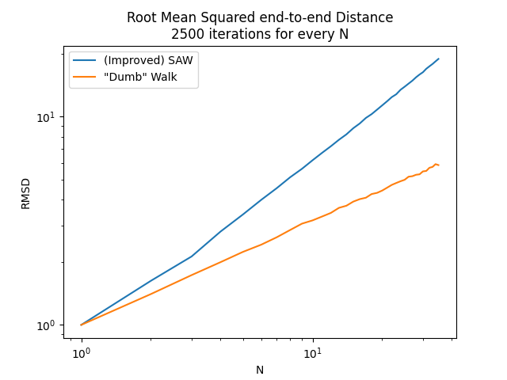
Part e)
RMSD for SAW
Close to linear
“Dumb” walk close to sqrt

Slide 11
2.2: Traffic Model using Cellular Automata
Simulating car traffic
Cars driving on long road
Cellular automata
Discrete: next state is completely determined by current state
Periodic boundary conditions
Simple set of rules that every “cell” obeys

Slide 12
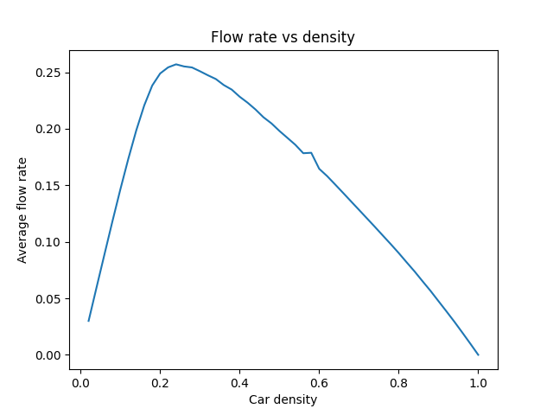
Part a)
Fundamental diagram
v_max = 2, p = 0.5
Plot average flow rate vs car density

Slide 13
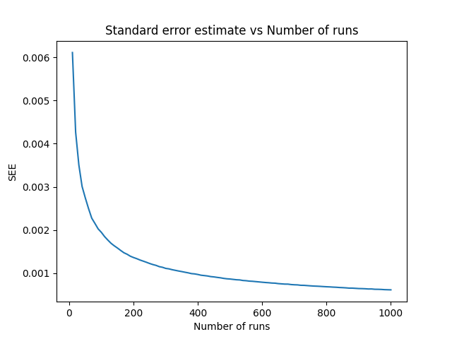
Part b)
Statistical accuracy
Standard error estimate
N = 380 => SEE < 0.001

Slide 14
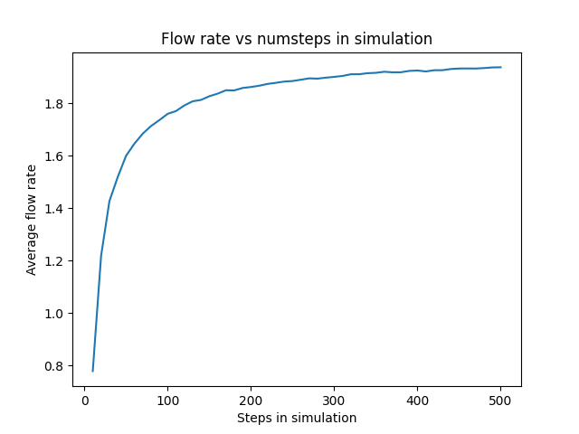
Part b)
Equilibration time
Standard error estimate
All values of AFR sampled, including during equilibration period
If only sampling equilibrium, N = 100 might be feasible
N >= 200

Slide 15
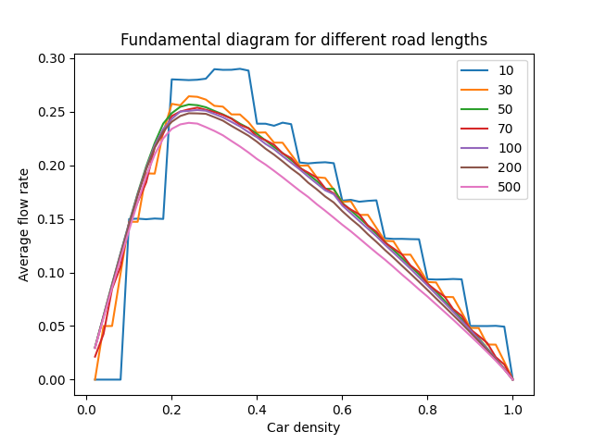
Part c)
System size independence
Fundamental diagram for multiple road lengths
By a road length of >= 50, the diagram stops changing
Integer rounding

Slide 16
Part d) and e)
Parameter tinkering
Varying v_max (d) and p (e)
Quantitative differences
What’s about to come
Fundamental diagrams for different v_max and p
Cross sections at different car densities

Slide 17
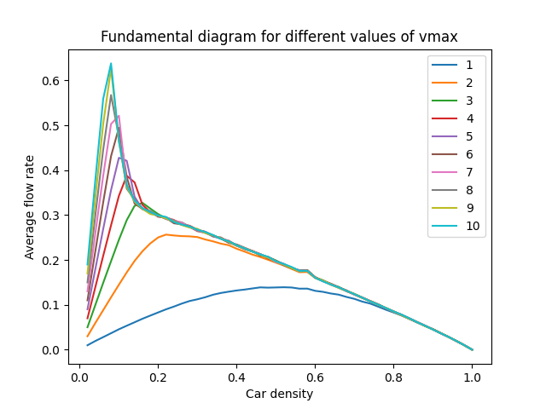
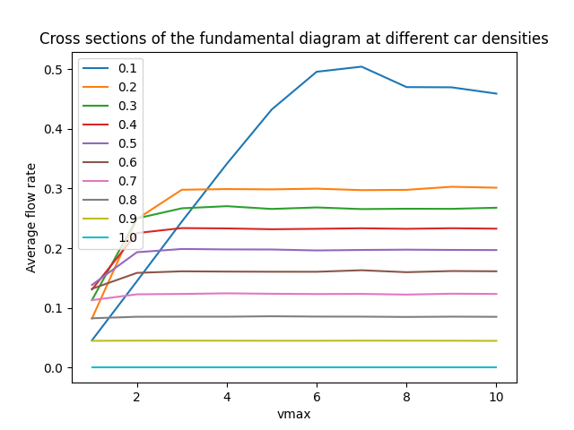
Part d)

Slide 18
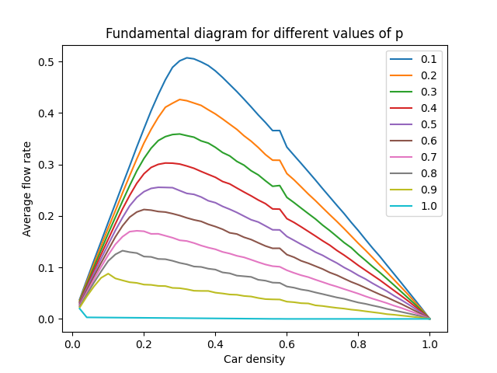
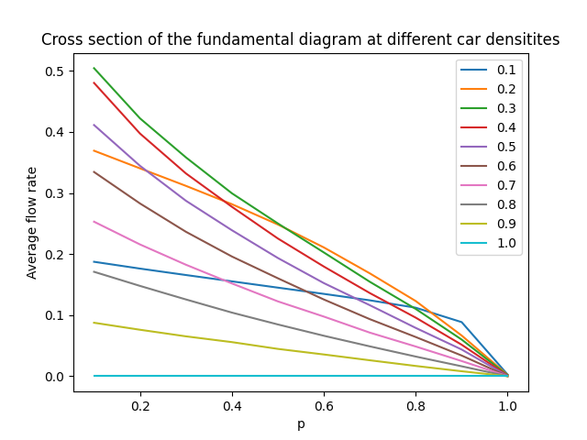
Part e)

Slide 19
Thank you!

